Slide 1
Analysis on Udemy online course data
Shreyas.C.R

Slide 2
Task
Goal:
Tasks
Data preprocessing
Build different regression models
Predict number of subscribers

Slide 3
Why BFSI Domain?
The Banking, Financial Services, and Insurance sector is a unique blend of Money, Technology and Rules and it's not shy to present its own set of distinct challenges and opportunities.
I chose BFSI Domain for my Capstone Project because :
Money Matters: BFSI handles tricky money stuff, so understanding how people use their money and predicting their actions is like solving a puzzle. BFSI handles tricky money stuff, so understanding how people use their money and predicting their actions is like solving a puzzle.
Rules Everywhere: There are lots of rules in BFSI. We have to play by these rules, and they keep changing. It's a challenge, but it also keeps things interesting.
Security: People's money info is super secret. We need to figure out how to analyze it without spilling the beans, making it a tricky but fascinating task.
Customers are unique: Everyone's money needs are different. Managing relationships with all kinds of customers adds another layer of complexity.
Tech is always changing: New tech stuff is always popping up, especially in finance. Figuring out how to use these tech innovations to help customers is part of the adventure.

Slide 4
Dataset Information
Here are the key details about the dataset used in this project:
Number of records: Our dataset comprises a robust collection of data, consisting of 10,000 records. Each record represents a unique entry, contributing to the richness and depth of our analysis.
Features/Columns: The dataset is characterized by a diverse set of features, each providing valuable insights into customer behavior, preferences, and interactions. In total, there are 14 features/columns that form the basis of our predictive modeling.
Source of the Data: The dataset is sourced from Kaggle, ensuring reliability and relevance. The data's origin plays a crucial role in shaping the context and ensuring that our analysis is grounded in real-world scenarios and industry dynamics.

Slide 5
Exploratory Data Analysis (EDA)
Exploring the data allowed us to gain a comprehensive overview of the data's structure. It uncovered potential patterns, helped us identify key trends and get essential insights from the dataset.
Throughout the EDA process, we analyzed the distribution of individual features, investigated correlations, and explored any inherent relationships between variables.
Visualizations also played a crucial role in providing a clear representation of the data, offering insights into customer behavior and identifying the factors that may contribute to customer churn.

Slide 6
Exploratory Data Analysis (EDA)
First, we made sure there were no Null values and Duplicates in the dataset. And luckily, there weren't any. Our dataset was clean to begin with.
Then, we checked our columns to see if they were providing any useful information for us to work with. We found out that columns like “RowNumber”, “CustomerID” and “Surname” weren't contributing much to the predictions. Hence, we decided to drop them during preprocessing.
The "Geography" and "Gender" columns in our dataset were categorical variables. For them to work with our model, it was necessary to convert these categorical features into a numerical format.
To ensure consistent scales for numerical features, we decided to employ Standard Scaler during preprocessing.

Slide 7
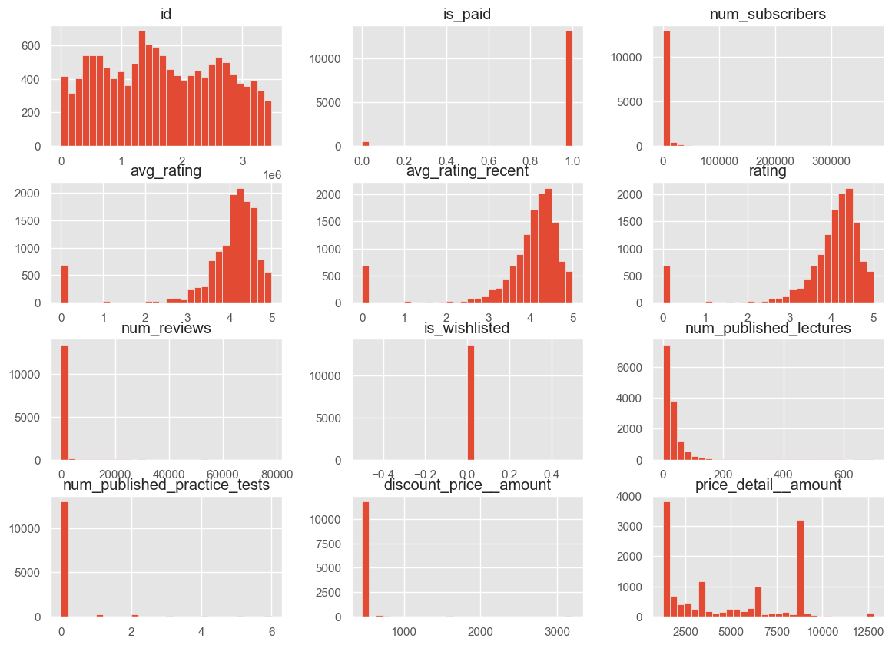
it depicts the relationships between various features of courses offered on an online platform. The color intensity indicates the strength of the correlation, with redder shades representing positive correlations and bluer shades representing negative correlations.

Slide 8
Train-Test Split
We then split the dataset into training data and testing data.
We did an 80:20 split, meaning 80% of our data is Training Data and 20% of our data is Testing Data. So, our test size was set to 0.2.
We took Random State as 123. This guaranteed the reproducibility of our results across different runs.
We also used Stratify = y to ensure that our Target Variable (y) is distributed proportionally.

Slide 9
Applying Machine Learning Algorithms
1.Random Forest
Type: Ensemble Learning, Bagging
Purpose: Handles high dimensional data well and reduces overfitting by averaging multiple decision trees.
2. XGBoost
Type: Ensemble Learning, Boosting
Purpose: Optimized and regularized version of Gradient Boosting, designed to be highly efficient, flexible, and portable.
3.Linear Regression
Type: Regression
Purpose: Predicts a continuous target variable based on one or more predictor variables.
4.Grid Search CV
Type: Hyperparameter Tuning
Purpose: Exhaustively searches for the optimal hyperparameters for a given model.

Slide 10
Evaluation Metrics
Model | R-squared Score | Mean Absolute Error | Mean Squared Error
XGBoost Regressor | 0.8459762216943133 | 244.65262832516598 | 16270964.233457373
Best Random Forest Regressor (Grid Search CV) | 0.973542573880309 | 84.77809077354986 | 2794943.993962133
Random Forest Regressor | 0.9750892898463961 | 233.45110935853532 | 2631550.0009023487
Linear Regression | 0.9999998840820523 | 1.4686731037105132 | 12.245490933381875
The table ranks the accuracy of various regression algorithms based on their R-squared scores, with Linear Regression achieving the highest accuracy. Random Forest Regressor (Grid Search CV) and XGBoost Regressor also perform well, while the standard Random Forest Regressor shows comparatively lower accuracy.

Slide 11
Model Selection and Considerations
1. Linear Regression:
- Simplicity: Straightforward to implement and interpret.
- Assumptions: Requires linear relationship between features and target variable.
- Performance: Achieved the highest R-squared score in this project, indicating excellent accuracy.
2. Random Forest:
- Ensemble Method: Combines multiple decision trees to improve accuracy and control overfitting.
- Parameter Tuning: Grid Search CV was used to find the best parameters for optimal performance.
- Performance: The tuned model performed slightly better than the standard implementation.
3. XGBoost:
- Gradient Boosting: Combines the predictions of multiple weak learners to produce a strong learner.
- Regularization: Includes techniques to prevent overfitting.
- Performance: Achieved high accuracy, slightly outperforming Random Forest Regressor.
4. Grid Search CV:
- Hyperparameter Optimization: Systematic approach to finding the best parameters for model performance.
- Cross-Validation: Ensures that the model generalizes well to unseen data.
5. Regularization in XGBoost:
- Prevents Overfitting: Adds a penalty to the model complexity to ensure it generalizes better.
- Code Implementation: Includes L1 (Lasso) and L2 (Ridge) regularization techniques.

Slide 12
Conclusion of the Project
Highest R-squared Score (0.99999988): R-squared indicates the proportion of variance explained by the model. A value closer to 1 suggests a better fit. Linear Regression has the highest R-squared score, signifying a strong correlation between predicted and actual values.
Lowest Mean Absolute Error (1.4687): MAE represents the average difference between predicted and actual values. Lower MAE indicates better model accuracy. Linear Regression has the lowest MAE, implying high prediction accuracy.
Lowest Mean Squared Error (12.2455): MSE squares the MAE, further penalizing larger errors. Linear Regression has the lowest MSE, again highlighting its strong performance.
It's important to note that:
While Linear Regression has the best metrics here, this might not always be the case. The choice of algorithm can depend on the specific dataset and problem.
Consider factors like model interpretability (Linear Regression is generally easier to interpret) and potential overfitting (especially with a very high R-squared) when making the final decision.

Slide 13
Thank You !

